Slide 1
Cancer Trends in Canada
DAB 304-005: HEALTHCARE ANALYTICS
Group 05
Jigar Patel(0794004)
Smit Arora (0795650)
Dhrumi Patel (0793770)
Bhakti Bhatt (0788808)
Vismay Lad (0794141)

Slide 2
Table of contents
Background/Motivation
Target audience
Dataset Description
Data Insights
Conclusion
Reference

Slide 3
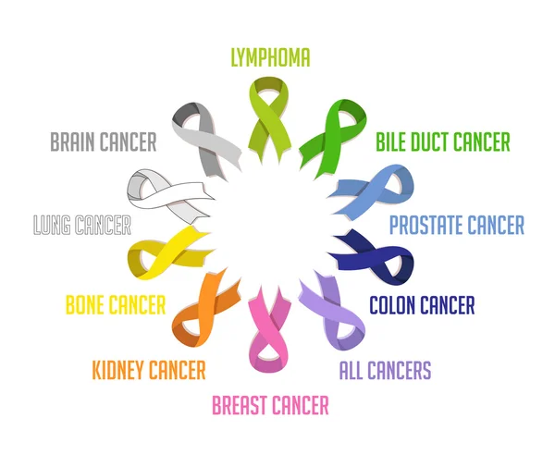
Background/Motivation
According to the 2018 Ontario Cancer Statistics, cancer is the leading cause of death in Ontario, accounting for 29.3% of all deaths.
In addition, more than twice as many cancer cases were registered in Ontario in 2013 as in 1983.
Cancer care costs in Ontario increased by over 150% from roughly $1 billion in 2005 to $2.6 billion in 2012.
Millions of lives could be saved each year by implementing resource-appropriate preventive, early detection, and treatment techniques.
One-third of all common cancers are avoidable.

Slide 4

Target audience
This project's intended audience may include any of the following individuals or groups:
Any medical school / institution
Any medical student
Any analysis student
Anyone interested in determining insights into all types of cancer.

Slide 5

Dataset Description
There are a total of seven separate Excel files.
Cancer Incidence
Cancer Mortality
Cancer Prevalence
Cancer Survival
Cancer Risk Factors
Cancer Screening
Socio-Demographic Factor

Slide 6
Dataset description – Cont’d
https://www.cancercareontario.ca/en/data-research/view-data/cancer-statistics/ontario-cancer-profiles
 | Observation | Feature
Cancer Incidence | 46740 | 13
Cancer Mortality | 88884 | 13
Cancer Prevalence | 17460 | 8
Cancer Survival | 7275 | 10
Cancer Risk Factor | 450 | 11
Cancer Screening | 135 | 7
Socio-Demographic Factor | 240 | 11

Slide 7
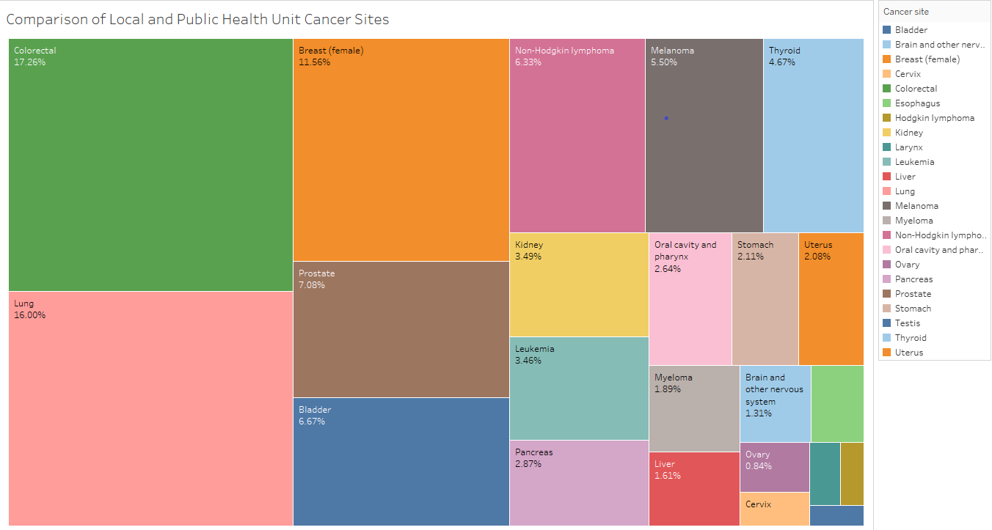
Data Insights
Cancer Incidence
As shown in the tree map, colorectal and lung cancers overwhelm all other cancer types in newly identified cases.

Slide 8
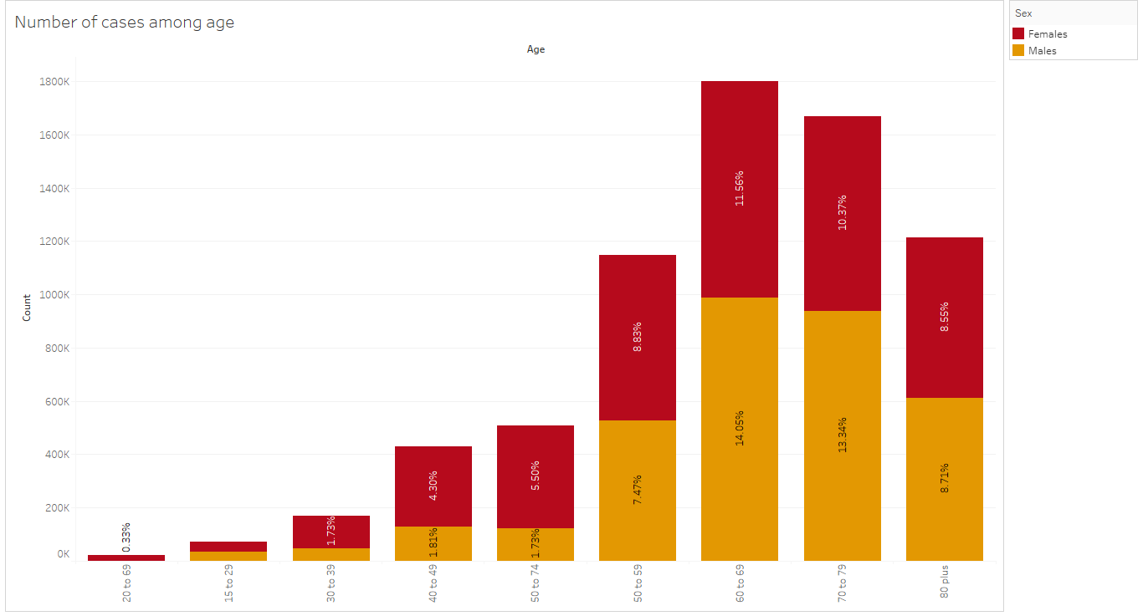
Cancer Incidence
The graph shows that beyond the age of 40, the number of cancer cases dramatically increased.
The 60- to 69-year-old demographic is a hotspot.

Slide 9
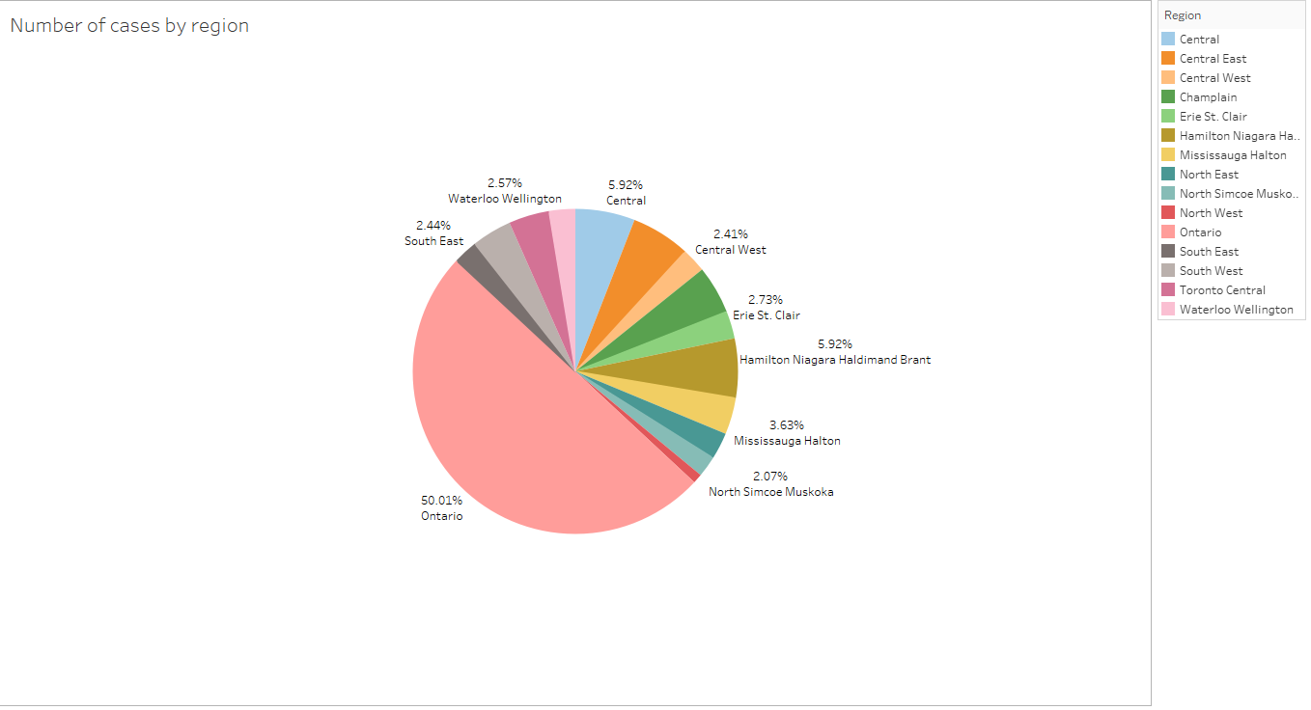
Cancer Incidence
According to this pie chart,
Ontario has more cancer
cases than any other region.

Slide 10
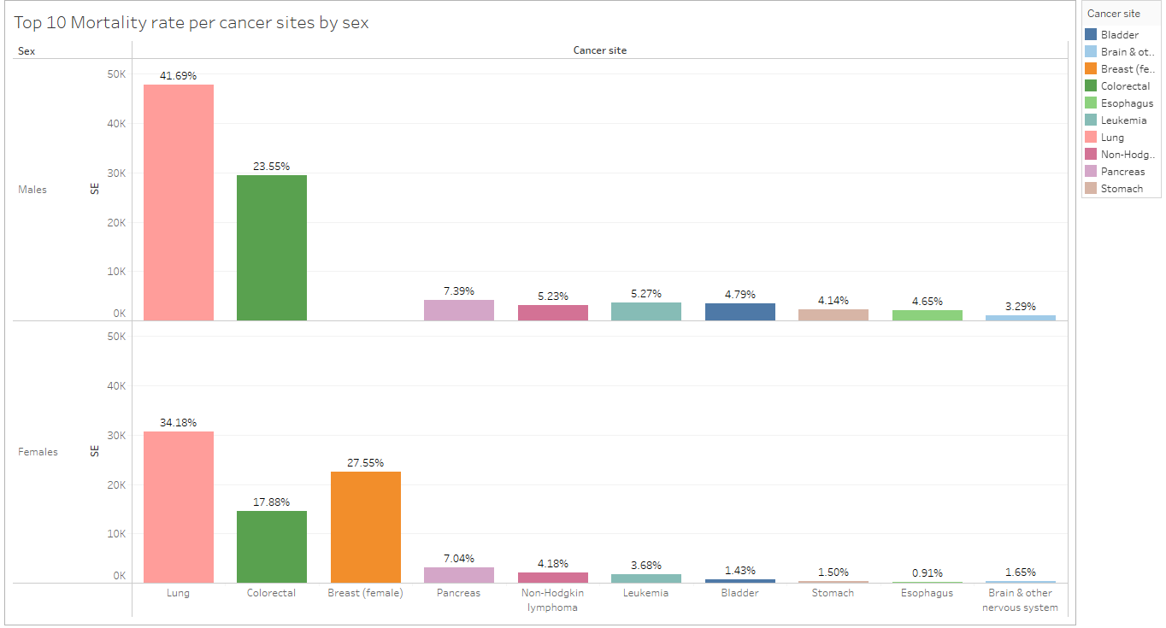
Cancer Mortality
This bar graph depicts the top 10 mortality rates for cancer sites by gender.

Slide 11
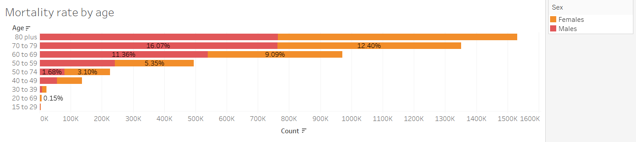
Cancer Mortality
The age counts of the death rate by gender are shown in this graph.
During adulthood, the death rate is extremely low.
On the other side, the mortality rate is highest for people between the ages of 50 and 74.

Slide 12
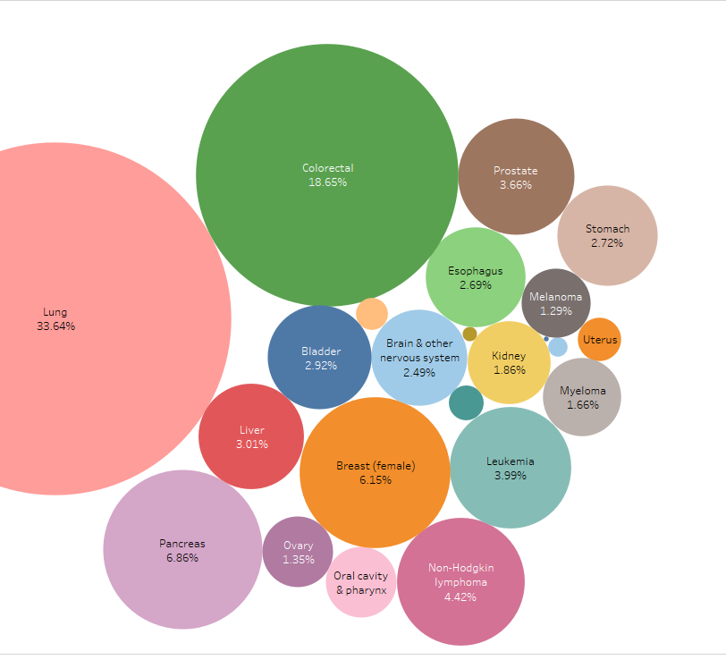
Cancer Mortality
The bubble graph demonstrates that lung cancer is the leading cause of cancer-related death in both men and women, followed by colorectal and pancreatic cancers.
The larynx and cervix, however, have a lower risk of dying.

Slide 13
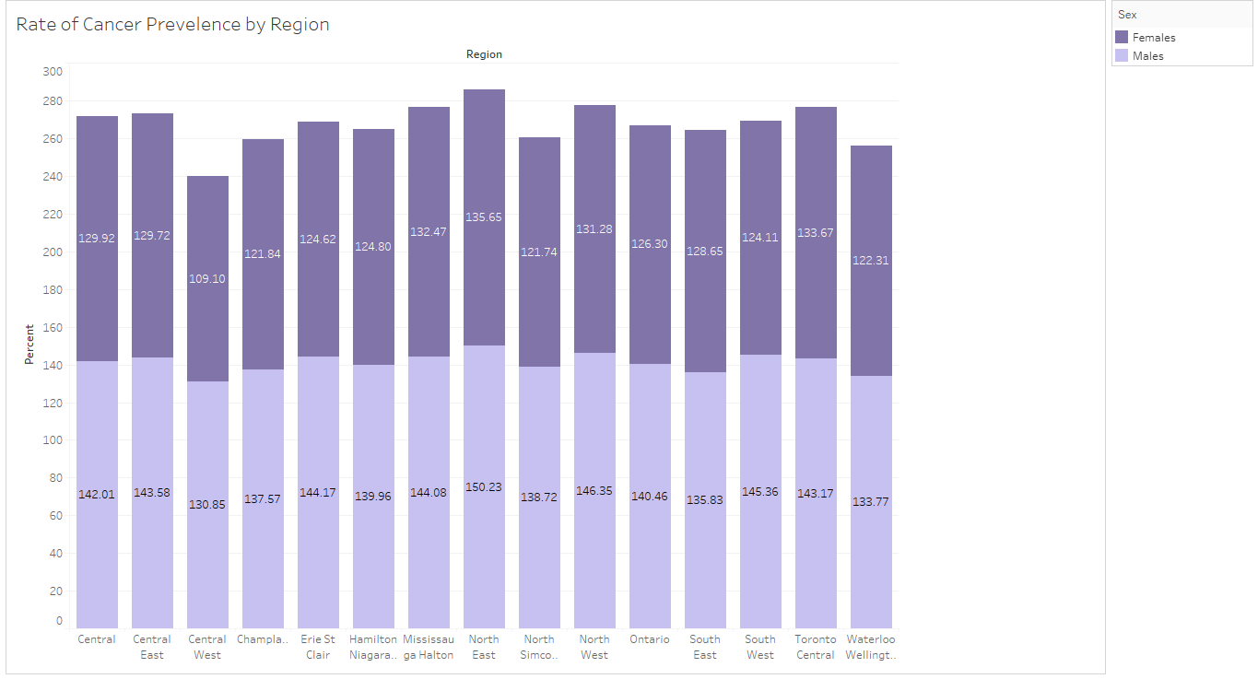
Cancer Prevalence
The overall percentage of the male and female cancer prevalence by region is shown in the following graph.
In every region, there were more men than women in terms of cancer prevalence.

Slide 14
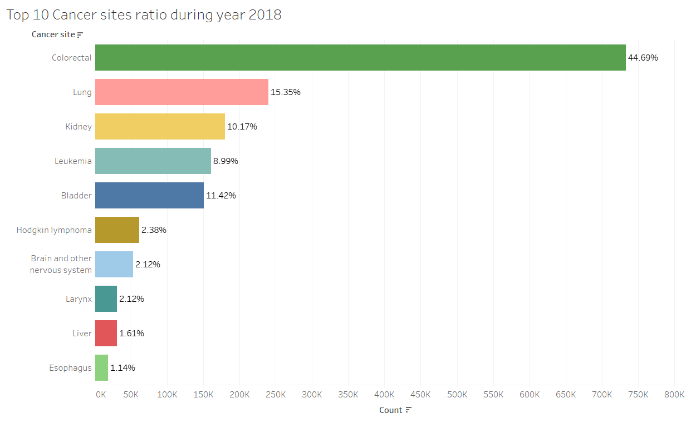
Cancer Prevalence
According to the bar graph, colorectal cancer had the highest rate followed by Lung and Kidney in 2018, at about 45%.

Slide 15
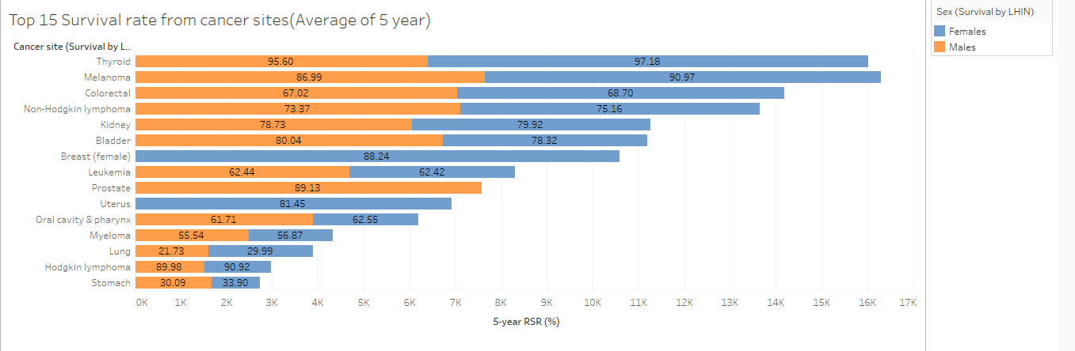
Cancer Survival
The cancer survivor who fought and is shown in the graph.
Female patients with thyroid and melanoma cancer now have a much higher five-year survival rate.

Slide 16
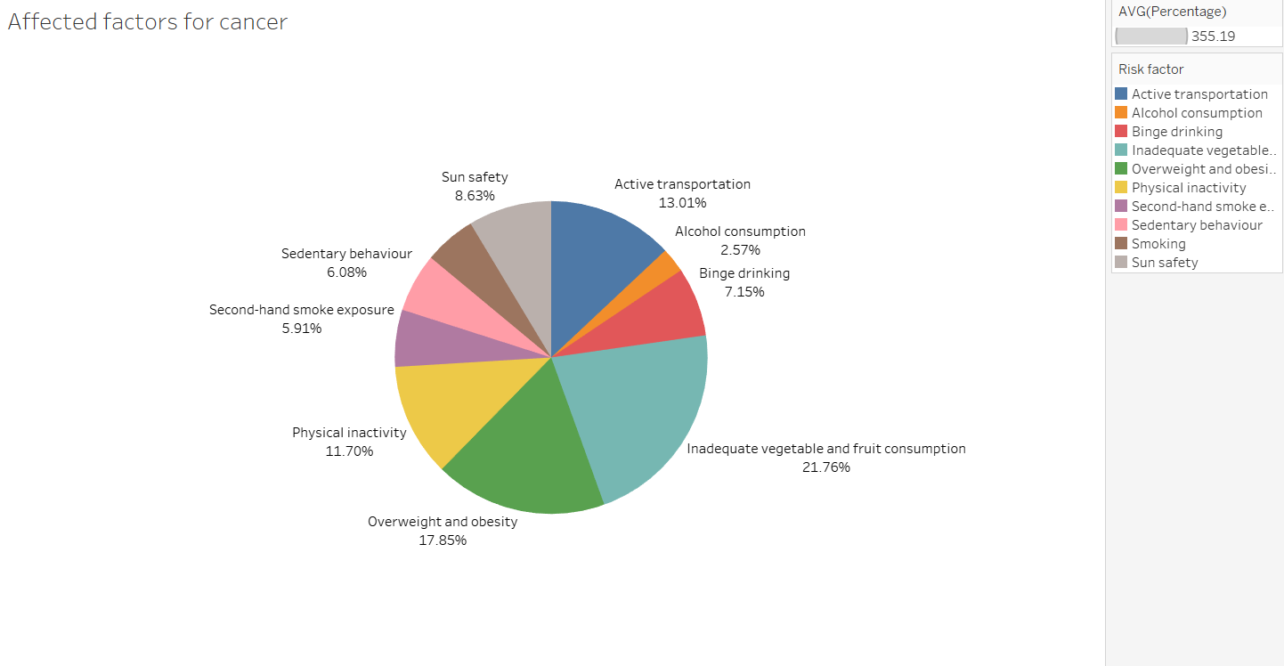
Cancer Risk Factors
This graph displays numerous elements, such as the most crucial factor being a lack of vegetables and fruits, followed by being overweight or obese.
Surprisingly, alcohol consumption appears to be the least affected factor.
Cancer might also be caused by a dearth of exercise.

Slide 17
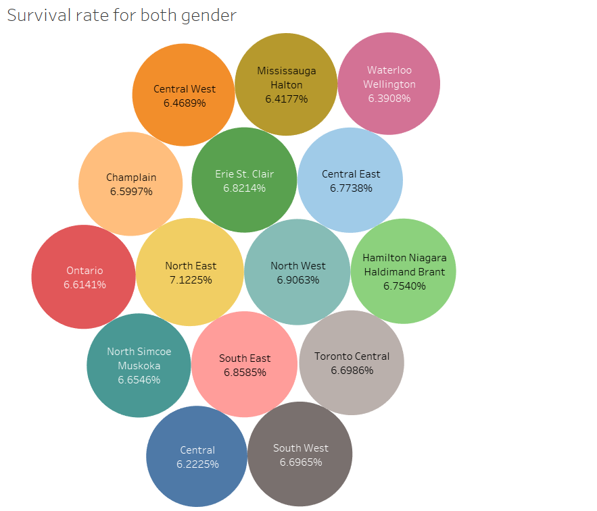
Cancer Risk Factors
The risk factors that are contributing to an increase in cancer cases by region are shown in the graph. Risky factors affect the Northeast Region the most.
However, other areas are close by in terms of population.

Slide 18
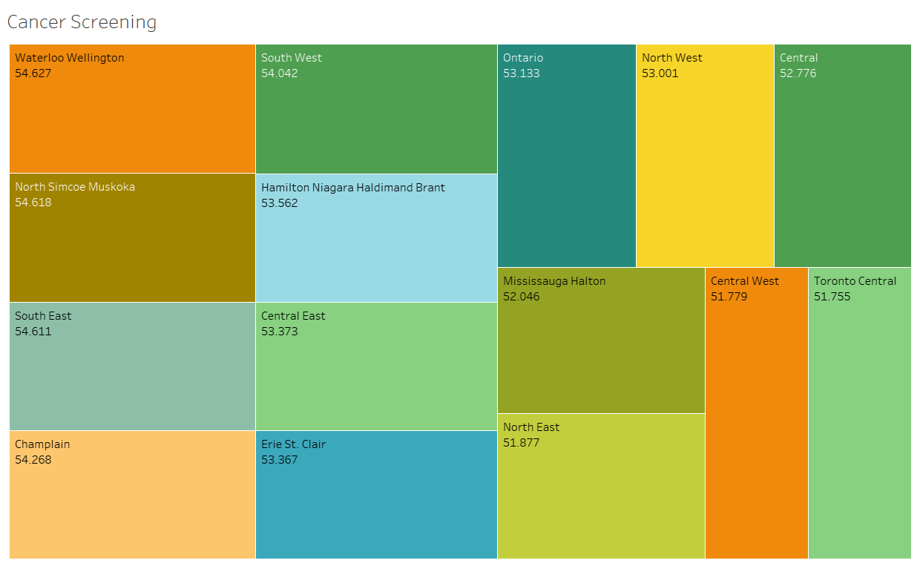
Cancer Screening
According to the given tree map, the Waterloo Wellington region has the highest screening rate, followed by North Simcoe Muskoka, Southeast, and Champlain.
The lowest screening rates, on the other side, are observed in Central West and Toronto Central.

Slide 19
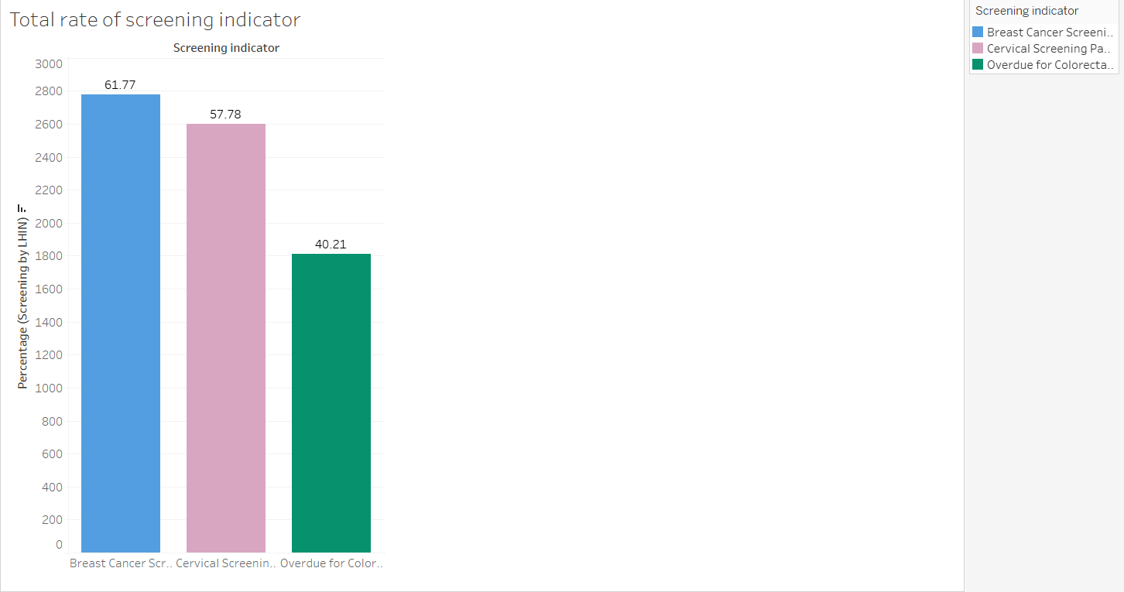
Cancer Screening
"Breast Cancer Screening Participation" has the highest rate, while "Overdue for Colorectal Cancer Screening" has the lowest.

Slide 20
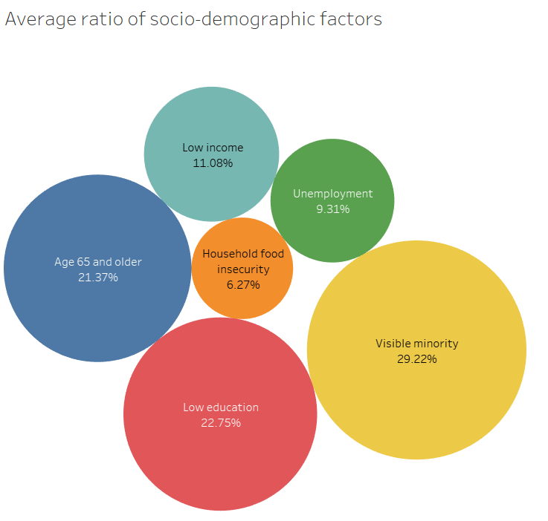
Socio Demographics in term of Cancer
The percentage of visible minorities(or persons, other than Aboriginal peoples, who are non-white in color) is the largest, yet household food insecurity is the lowest.

Slide 21

Conclusion
As we all know, there are more than 100 different cancers that harm humans.
When you simply search type of cancer, you will get a long list that includes all of the alphabet except J, Q, X, and Z.
Our doctors and researchers are working hard to treat all types of cancer, but for our own safety, we must perform full-body scans to diagnose and prevent such things.

Slide 22
Reference
https://www.cancercareontario.ca/en/statistical-reports/ontario-cancer-statistics-2020/ch-1-estimated-current-cancer-incidence
https://www.cancercareontario.ca/en/statistical-reports/ontario-cancer-statistics-2020/ch-2-estimated-current-cancer-mortality
https://www.cancercareontario.ca/en/statistical-reports/ontario-cancer-statistics-2020/ch-7-cancer-survival
https://www.cancercareontario.ca/en/statistical-reports/ontario-cancer-statistics-2020/ch-8-cancer-prevalence
https://www.ncbi.nlm.nih.gov/pmc/articles/PMC5999161/
https://www.cancer.gov/about-cancer/screening

Slide 23
Thank you….

